Slide 1
Diversity in the Workplace
Team Members: Jessica Camacho, Gaston Shefa, Thomas Ye, Neco Hinton
Netflix Data Science Foundations Boot Camp Midterm Project

Slide 2
Project Overview
Goal: Help employers find well-fitting employees
1.Is it better to have married workers or unmarried workers?
2.Do different departments attract different genders?

Slide 3
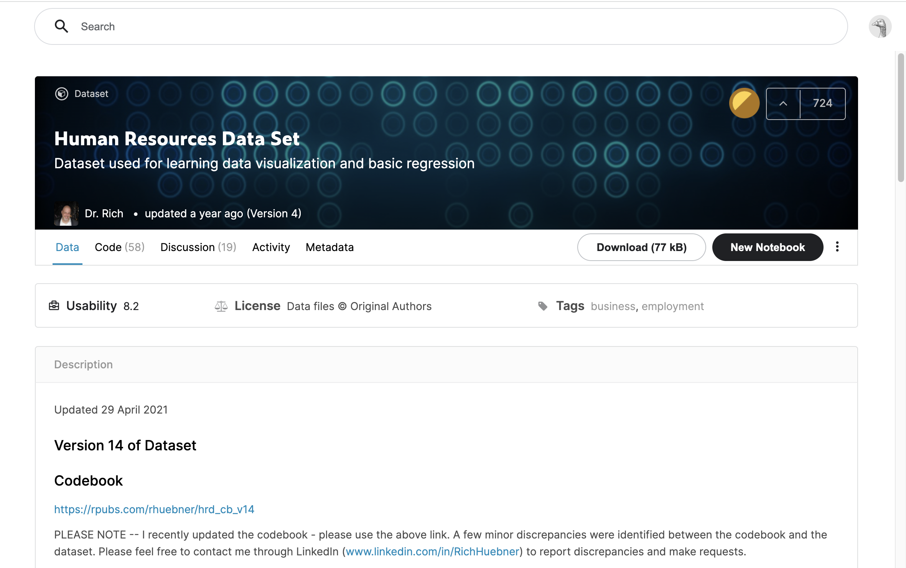
Our Data
General human resources data set created by two HR professors on Kaggle:
https://www.kaggle.com/rhuebner/human-resources-data-set?select=HRDataset_v14.csv
Notes:
Our data set used was created by Dr. Patalano and Dr. Heubner. Because there is not a lot of public HR data, this data is based on a fictious organization and is used to teach other students how to analyze and understand HR data. More about the dataset here:

Slide 4
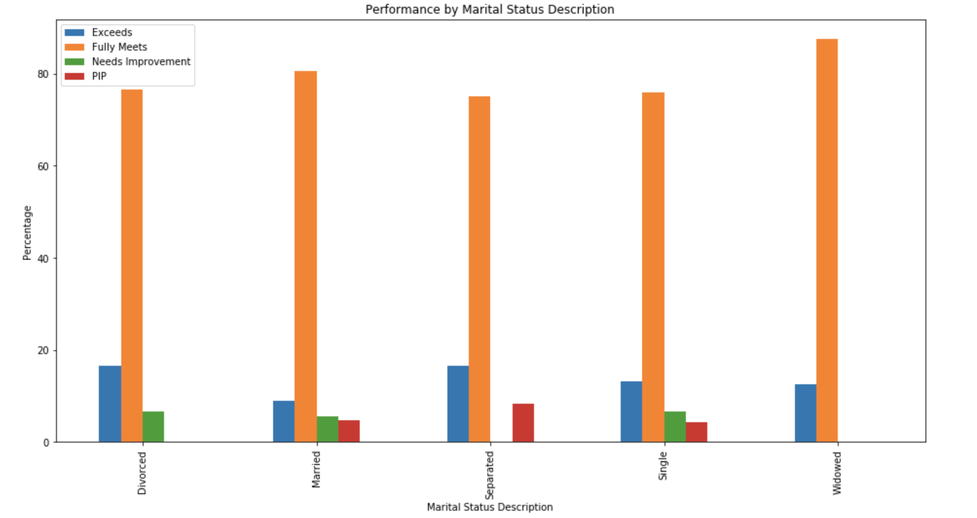
Requirement #1
Unmarried employees and married employees performed roughly the same level.
Notes:
Unmarried people tended to perform slightly better by very slim margins: 90.37% of unmarried employees fully met/exceed expectations vs 89.51% of married employees fully met/employees. That means rough 10% of both married and unmarried employees performed below standards. What seems to be significant however, is that unmarried employees tended to exceed expectations at a significant level 13.9% vs 8.8%. This can be attributed due to lack of household responsibilities, nobody cares if you come home at a certain time so you have more ability to stay at work and put in the extra hours that the married individual can’t.
PIP = performance improvement plan

Slide 5
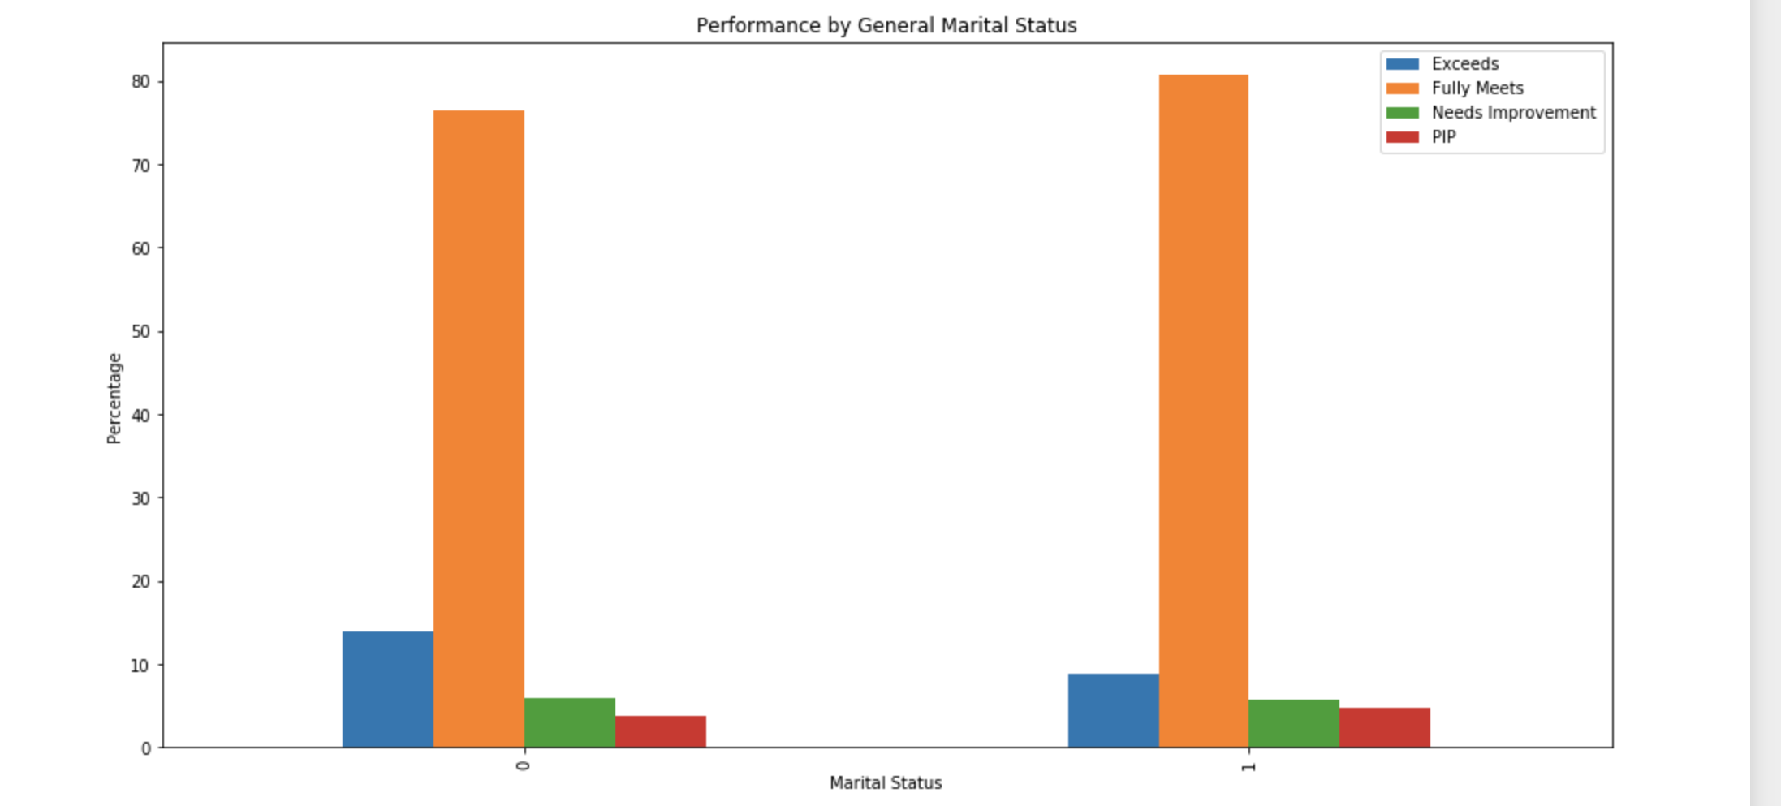
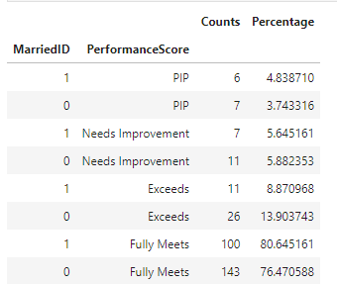
Requirement #1
Unmarried employees and married employees performed roughly the same level.
Notes:
Unmarried people tended to perform slightly better by very slim margins: 90.37% of unmarried employees fully met/exceed expectations vs 89.51% of married employees fully met/employees. That means rough 10% of both married and unmarried employees performed below standards. What seems to be significant however, is that unmarried employees tended to exceed expectations at a significant level 13.9% vs 8.8%. This can be attributed due to lack of household responsibilities, nobody cares if you come home at a certain time so you have more ability to stay at work and put in the extra hours that the married individual can’t.
50% percentile score of 3 or higher (fully meets and exceeds expectations)

Slide 6
Question / Visualization #1
Is it better to have married workers or unmarried workers?
Answer: It depends. Are you a start-up, do you need people to exceed expectations? If so, you’ll likely want to hire unmarried employees because they’ll be more likely to exceed expectations. Otherwise, in most situations, it doesn’t matter what type of employee you have based off of marital status.
Notes:
Summary of the results. Basically the statement on Requirement #1.

Slide 7
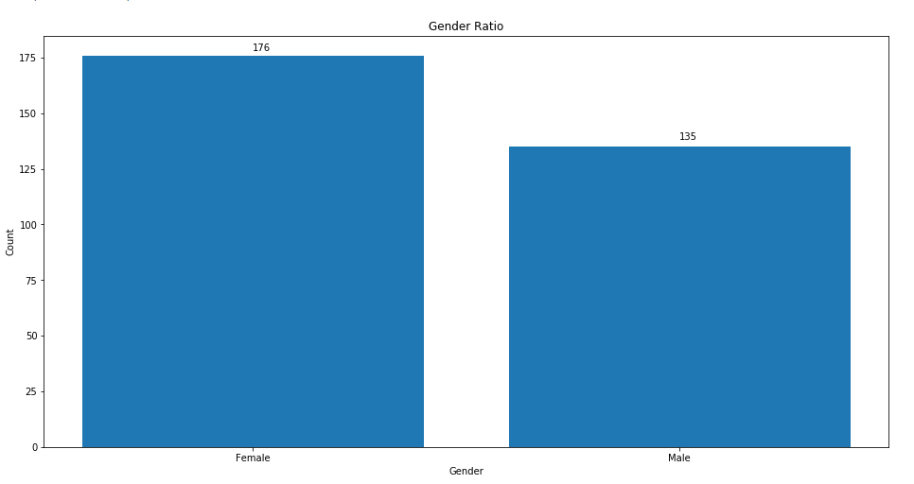
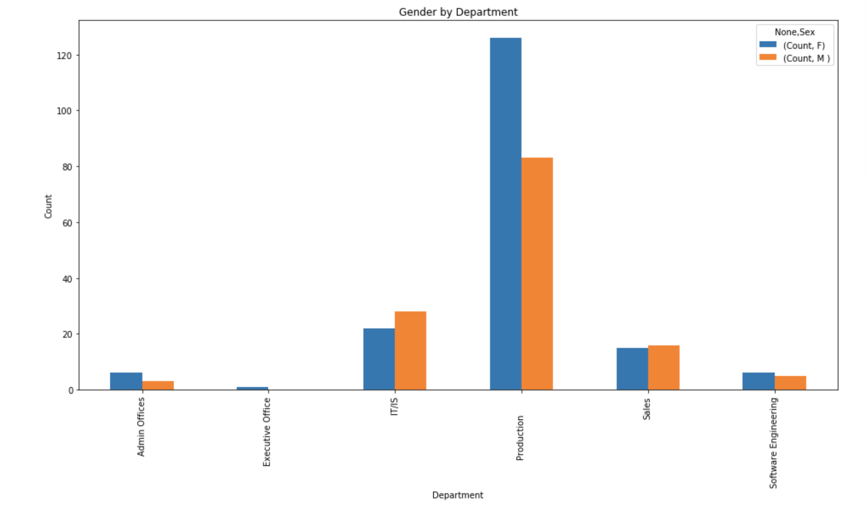
Requirement #2
Gender ratios differ from department to department, some are balanced while others are heavily skewed
Notes:
As you can see, in this company females drastically outnumber males, so if there’s a small imbalance between men and women where women lead, it’s likely to be reflective of the overall company rather than the department.

Slide 8
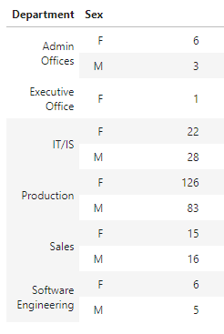
Question / Visualization #2
Do different departments attract different genders?
Answer: Yes. Different departments do attract different genders. Although our data wasn’t normalized to account for the company gender ratio, some results are convincing. This company has a female skewed production department the IT department was male skewed. The other departments seemed to attract similar amounts of female male relative to the company gender ratio.
Notes:
Summary of the results. Basically the statement on Requirement #1.

Slide 9
Summary.
I wou
This company should hire more unmarried employees. They tend to perform better at the higher end.
The overall gender diversity of the organization needs to be considered first before diving into the departmental levels.
Notes:
Noting the balance of counts and standard deviation needs to be considered.

Slide 10
Problems Encountered.
Low sample size. It’s hard to make a claim based on department for executives when there’s only one executive.
Unequal populations. Ideally, men and women would be equal populations so the data is more normalized.
Notes:
Mention that there selected a dataset with more organizations than just one.

Slide 11

Future Questions
Questions for the future
Do departments differ in average performance?
Does gender play a role in performance?
Do certain departments have more unmarried employees?
Notes:
Which department should you reduce funds/Give more training to?
Should you hire more of one gender or another?
Since unmarried employees tend to perform better, is it just because they are in a well-performing department?

